Slide 1
Programming For Video Games
Game Design

Slide 2
Game Design
Core Game Loop – The central mechanic that the game revolves around. This usually involves a goal, an action, and a reward.
Mario Game Loop:
Move to the right -> Jump on enemies -> Collect points/powerups
Tetris Game Loop:
Rotate/align blocks -> Clear the screen -> Collect points/next level
Importance of Knowing your Game Loop

Slide 3
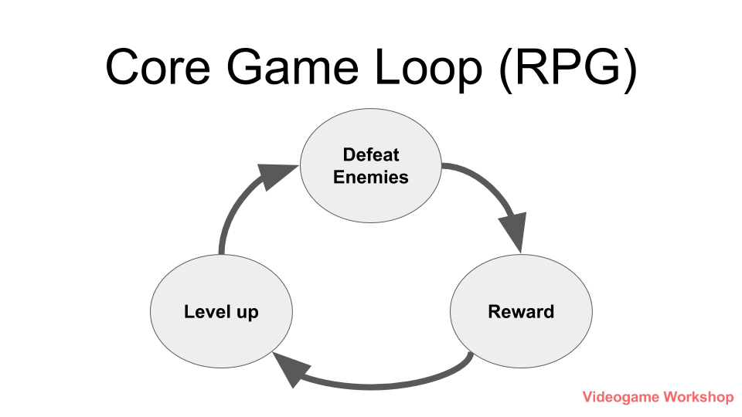
Game Design
Image Source: videogameworkshop.com

Slide 4
Game Design
Player Agency – The effect the player has on the game.
Gameplay – Does the game take control away from the player?
TrapAdventure 2

Slide 5
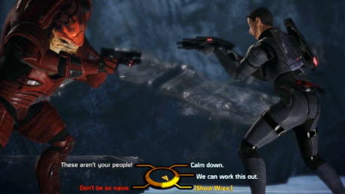
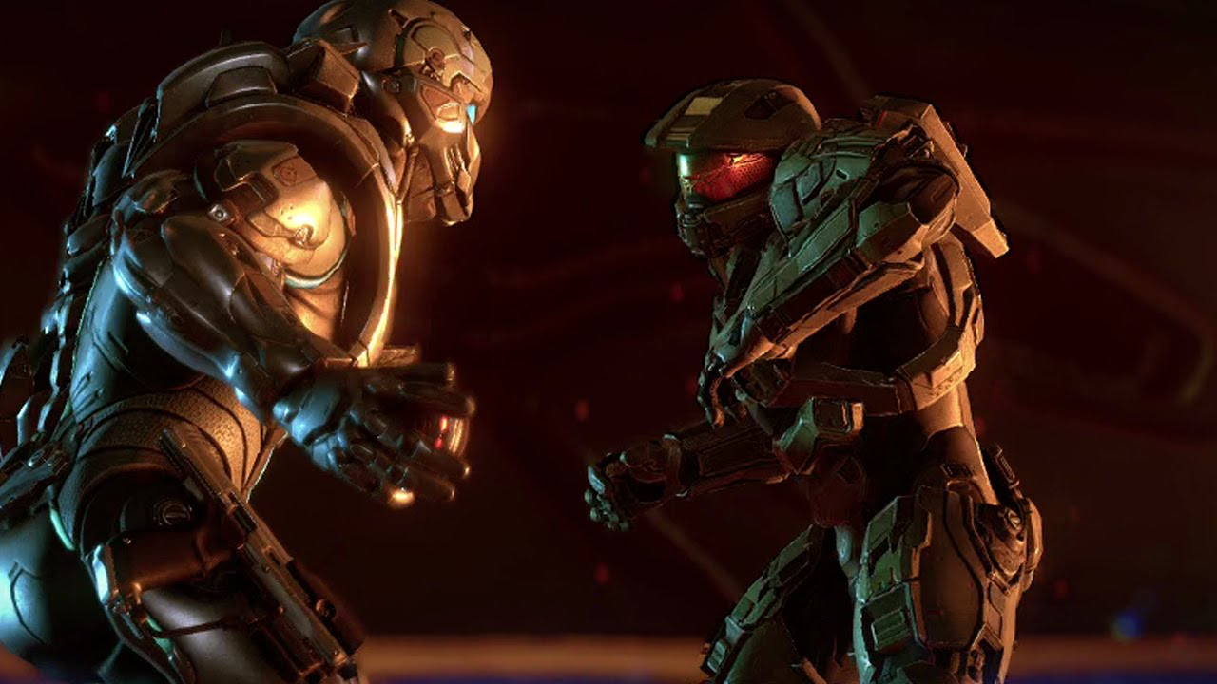
Game Design
Story Agency - Can the player affect the outcome of the story?
Mass Effect
Halo 5

Slide 6
Game Design
Tutorial – An interactive method of transferring knowledge. In a game, the player should be given a space to learn the controls and mechanics of the game.
Super Mario Bros

Slide 7
Game Design
Skill Floor – The minimum level for a player to play the game effectively.
Skill Ceiling – The experience required for a player to master the game mechanics.
Games can have a the following combinations:
Low Skill Floor and low Skill Ceiling
Low Skill Floor and high Skill Ceiling
High Skill Floor and high Skill Ceiling
High Skill Floor and low Skill Ceiling

Slide 8
Game Design
Skill Floor and Ceiling Examples:
Mario games typically have a low skill floor and a high skill ceiling. They are easy to start playing and complete. If a player masters the mechanics, they are rewarded with bonus levels and additional challenges.
“Souls” style of games typically have a high skill floor and ceiling. They require more experience and skill to play well.
“Hero” style multiplayer games will vary. One hero may have a low skill floor and ceiling to attract new players, and another will have a high skill ceiling to reward professional players.

Slide 9
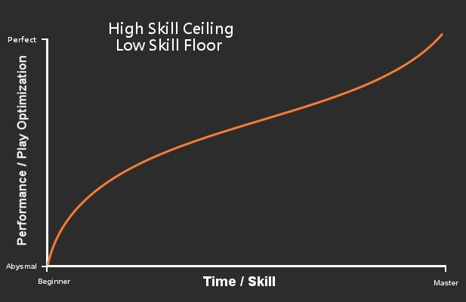
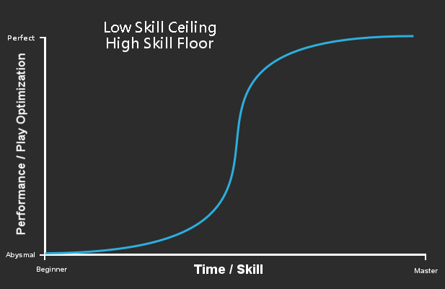
Game Design
Image Source: teamaretuza.com

